Slide 1
Data Structures and Algorithms IICT-6005
Lesson 9 – Analyzing Recursive Algorithms

Slide 2
Lesson Content
Revision: What is a recursive algorithm?
Recurrence equations
Time to complete a recursive algorithm
Analysing the recurrence equation
Recursion-tree method

Slide 3
Revision: What is a recursive algorithm?
Define a recursive algorithm.
A Recursive Algorithm where the main problem can be described in terms of sub-problems that are identical to it.
There the main problem can be solved by an algorithm which calls itself with "smaller (or simpler)" input values.
The results obtained from solving these simpler versions of the algorithm are then used to solve the main problem

Slide 4
Time to complete a recursive algorithm
Consider one of the algorithms you implemented recursively from one of the introductory exercises.
What is the Time Function T(n) describing how long the algorithm would take to complete for a problem of size n?

Slide 5
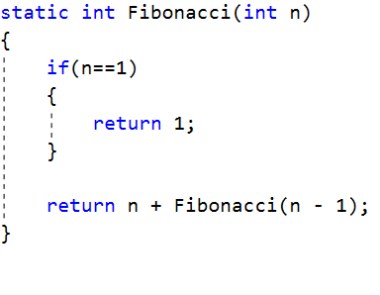
Time to complete a recursive algorithm
Let’s assume that we have the following algorithm to work out the Fibonacci Sequence for a number.
The algorithm can do 2 things
Hit the Base Case because n = 1 Stop Executing This is also the Best Case
Repeat itself with a value of
n-1 because n is not 1 yet

Slide 6
Time to complete a recursive algorithm
Therefore for our Recursive Algorithms we have to take note of two Time Functions
The T(n) for the Base Case
1
T(n) = 1 + 1
T(n) = 2
1
0

Slide 7
Time to complete a recursive algorithm
Therefore for our Recursive Algorithms we have to take note of two Time Functions
The T(n) for the Recursive Case
1
T(n) = 1 + 0 + 1 +T(n – 1)
T(n) = 2 + T(n – 1)
0
1
T(n-1)

Slide 8
Time to complete a recursive algorithm
Therefore Total Time taken to work out the Recursive Fibonacci is:
T(n) = T(n) for Base Case + T(n) for Recursive Case
T(n) = 2 + 2 + T(n – 1)
T(n) = 4 + T(n – 1)
This is known as the Recurrence Equation

Slide 9
Analysing the recurrence equations
How do we extract the asymptotic speed from the Recurrence Equation?
T(n) = 4 + T(n – 1)
Since the Recurrence Equation is not completely solved i.e. we still have T(n-1) as part of the equation, we cannot simply take the highest value of n and express it in terms of Big O notation.
We need to solve the T(n – 1) part of the equation before we can do this.

Slide 10
Solving Recurrence Equations
There are mainly three ways for solving recurrences:
The Substitution Method
The Recurrence Tree Method
The Master Theorem Method
For the purposes of this unit, we shall consider only the Master Theorem Method for solving Recurrence Equations.
The other 2 methods are explained briefly in the Further Readings provided for this topic on Moodle.
Link : https://moodle.mcast.edu.mt/mod/resource/view.php?id=64801

Slide 11

Master Theorem Method
The Master Theorem can be used to solve Recurrence Equations which are in the following form:
WHERE:
n → the size of the problem
a → the number of sub-problems into which n can be split
n/b → the size of each sub – problem
f(n) → the time cost done outside the recursive calls but still incurred by the algorithm

Slide 12
Master Theorem Method
The Master Theorem can be used to solve Recurrence Equations which are in the following form:
If the Recurrence Equation is not in this format,
the Master Theorem Method cannot be applied!

Slide 13
Master Theorem Method
How do we work out Master Theorem?
From the following equation identify values for
a : the multiplier i.e. the number by which the T(n) function is being multiplied
b : the number by which n is being divided in the T(n) function
c : the power of the highest value of n in the f(n) part of the equation

Slide 14
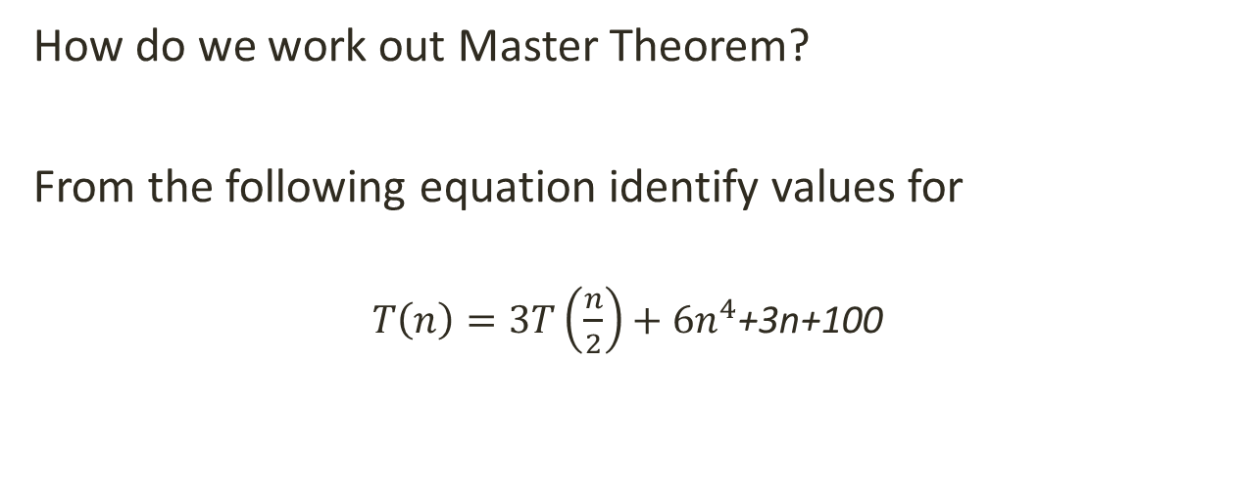
Master Theorem Method
How do we work out Master Theorem?
From the following equation identify values for
$T\left(n\right)=3T\left(\frac{n}{2}\right)+{6n}^{4}$+3n+100
c
a
f(n)
b
a : 3 the number by which the T(n) function is multiplied
b : 2 the number by which n is being divided in the T) function
c : 4 the power of the highest value of n in the f(n) function

Slide 15
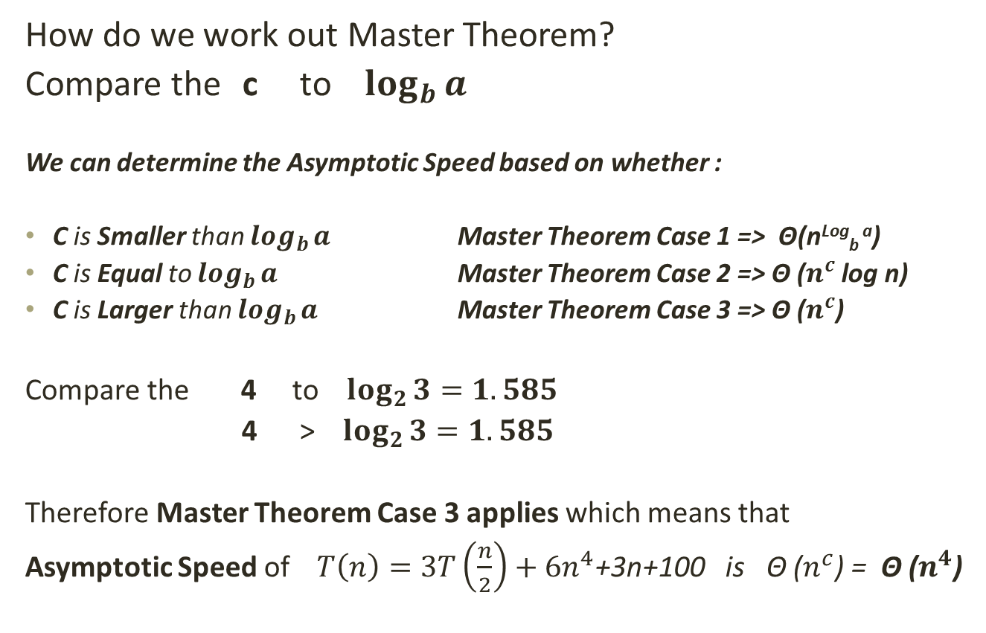
Master Theorem Method
How do we work out Master Theorem?
Compare the c to $\log_{b}{a}$
We can determine the Asymptotic Speed based on whether :
C is Smaller than $\log_{b}{a}$ Master Theorem Case 1 => Θ(n^{Log}_{b} ª)
C is Equal to $\log_{b}{a}$ Master Theorem Case 2 => Θ ($n^{c}$ log n)
C is Larger than $\log_{b}{a}$ Master Theorem Case 3 => Θ ($n^{c}$)
Compare the 4 to $\log_{2}{3}=1.585$
4 > $\log_{2}{3}=1.585$
Therefore Master Theorem Case 3 applies which means that
Asymptotic Speed of $T\left(n\right)=3T\left(\frac{n}{2}\right)+{6n}^{4}$+3n+100 is Θ ($n^{c}$) = Θ ($n^{4}$)

Slide 16
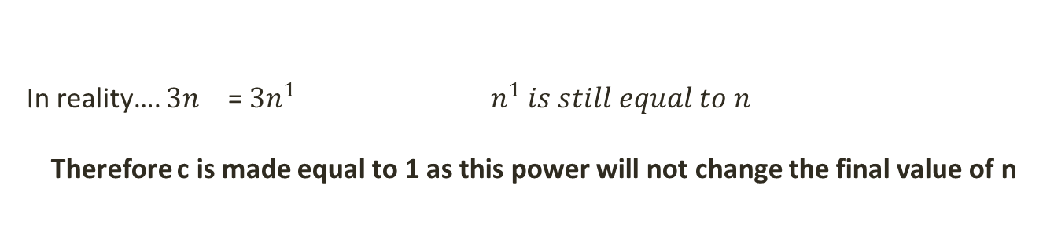
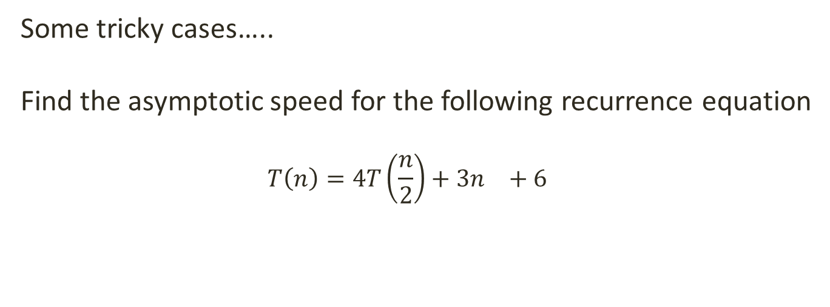
Master Theorem Method
Some tricky cases…..
Find the asymptotic speed for the following recurrence equation
$$T\left(n\right)=4T\left(\frac{n}{2}\right)+{3n}^{}+6$$
C = ?
a
b
f(n)
In the f(n) part of the recurrence equation, n does not have a power!
To find the value of c, we must add a power to n but we must also take care that this power does not change the final value of n
In reality…. ${3n}^{}$ = ${3n}^{1}$ $n^{1} is still equal to n$
Therefore c is made equal to 1 as this power will not change the final value of n

Slide 17

Master Theorem Method
Some tricky cases…..
Find the asymptotic speed for the following recurrence equation
$$T\left(n\right)=4T\left(\frac{n}{2}\right)+{3n}^{}+6$$
C = 1
a
f(n)
Therefore compare c to $\log_{b}{a}$
1 to $\log_{2}{4=2}$
c < $\log_{b}{a}$
Master Theorem Case 1 Applies
Asymptotic Speed is Θ(n^{Log}_{b} ª) = Θ(n^{Log}₂ ⁴)
b

Slide 18
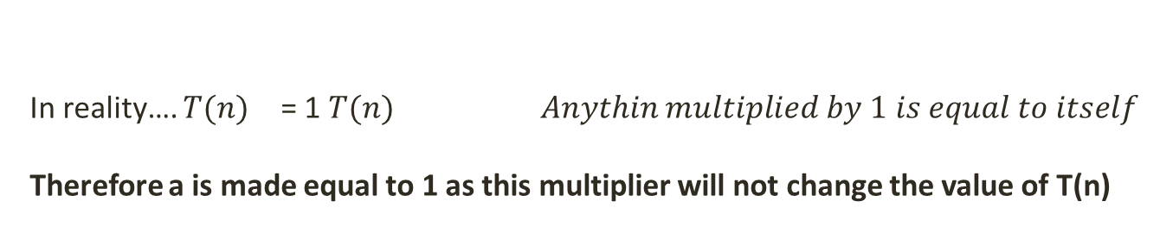
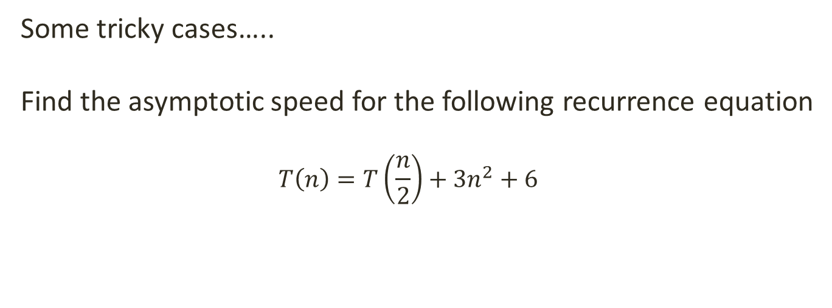
Master Theorem Method
Some tricky cases…..
Find the asymptotic speed for the following recurrence equation
$$T\left(n\right)=T\left(\frac{n}{2}\right)+{3n}^{2}+6$$
C = 2
a = ?
b
f(n)
The recurrence equation does not a value for a - the multiplier for the T(n) function!
To find the value for a, we must add a multiplier to T(n) but we must also take care that this multiplier does not change the final value of the T(n) function
In reality…. ${T(n)}^{}$ = 1 $T(n)$ $Anythin multiplied by 1 is equal to itself$
Therefore a is made equal to 1 as this multiplier will not change the value of T(n)

Slide 19

Master Theorem Method
Some tricky cases…..
Find the asymptotic speed for the following recurrence equation
$$T\left(n\right)=T\left(\frac{n}{2}\right)+{3n}^{2}+6$$
C = 2
a = 1
b
f(n)
Therefore compare c to $\log_{b}{a}$
2 to $\log_{2}{1=0}$
c > $\log_{b}{a}$
Master Theorem Case 3 Applies
Asymptotic Speed is Θ(n^{c}) = Θ(n²)

Slide 20
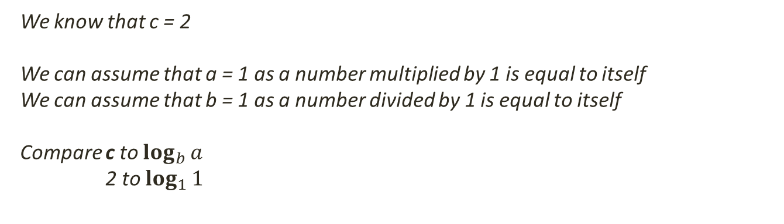

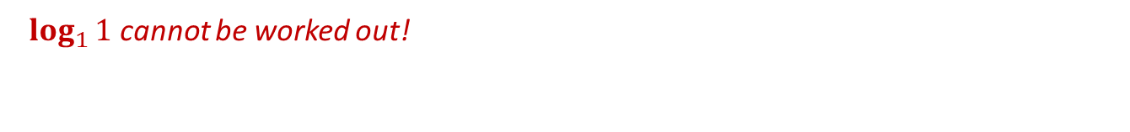
Master Theorem Method
Proof that Master Theorem does not work for recurrence equations unless they are in the correct format
$$T\left(n\right)=T\left(n\right)+{3n}^{2}+6$$
C = 2
a = ?
b = ?
f(n)
We know that c = 2
We can assume that a = 1 as a number multiplied by 1 is equal to itself
We can assume that b = 1 as a number divided by 1 is equal to itself
Compare c to $\log_{b}{a}$
2 to $\log_{1}{1}$
Hence the asymptotic speed of this recurrence equation cannot be determined using Master Theorem Method
$\log_{1}{1}$ cannot be worked out!

Slide 21
Summary
Revision: What is a recursive algorithm?
Recurrence equations
Time to complete a recursive algorithm
Analysing the recurrence equation
Master Theorem Method

Slide 22
End of lesson
Any questions?

